Slide 1
ACE Learner Success Lab
(Senate Presentation)
March 21, 2022

Slide 2
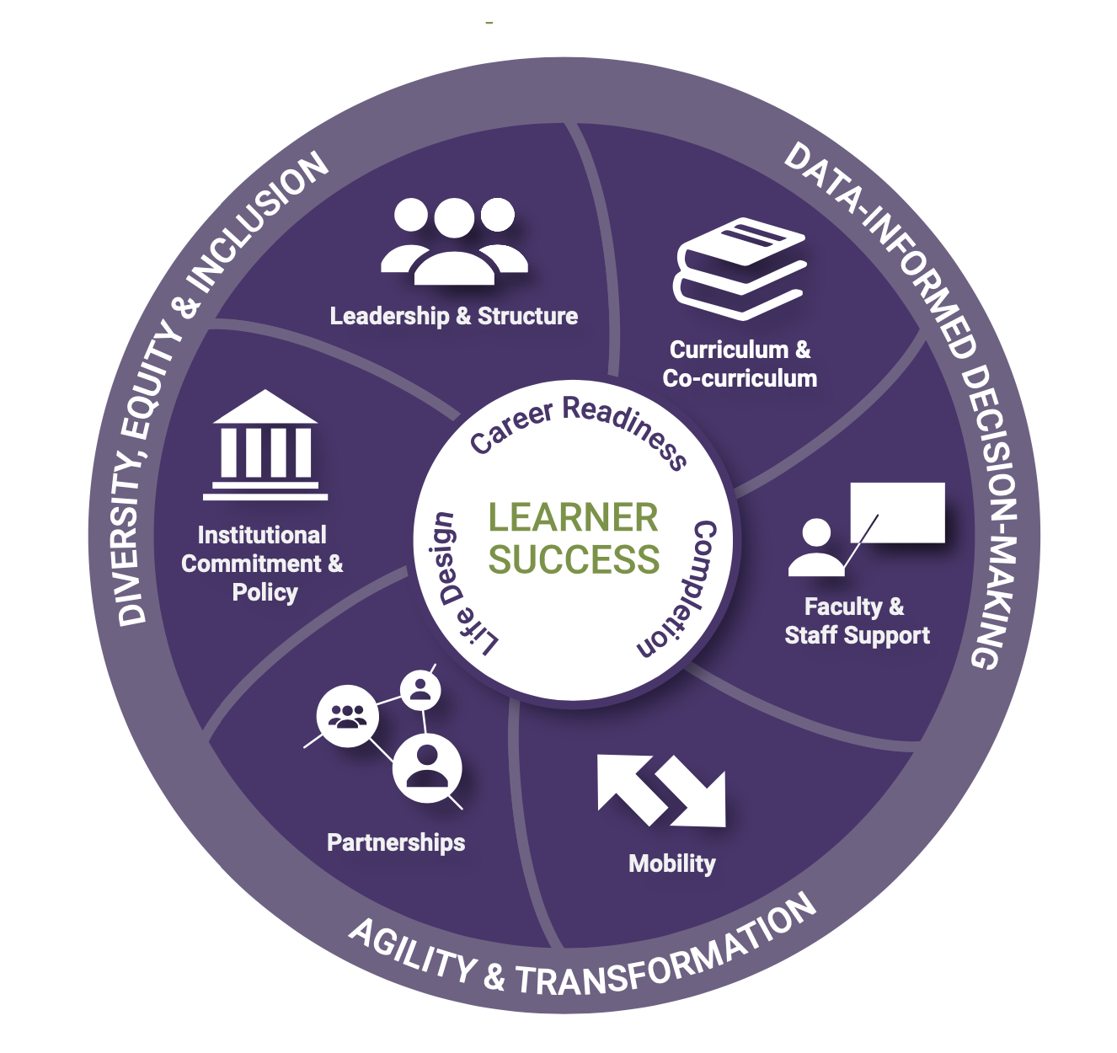
American Council on Education
The Learner Success Lab is an opportunity to evaluate our academic and support systems from the learner’s perspective, reflecting on what we do well, what we need to work on, and how best to support learners throughout their academic years and beyond.
NJCU is 1 of 10 institutions participating in Cohort 2.
We’re working with a coach—Boston University’s Mary Churchill—to help us guide us in our work.
It is an 18-month long process.

Slide 3
Steering Committee
The Steering Committee is composed of:
Provost Tamara Jhashi
Vice President Jodi Bailey
Associate Provost Nurdan Aydin
And the Co-Chairs
Associate Provost Gail Fernandez
SOAR Director Veronica Garcia
Interim Associate Dean of Arts and Sciences,
Humanities, Arts, and Social Sciences Jason Martinek

Slide 4
Three Working Groups Focusing On Three Crucial Areas of Learner Success
Creating a Center for Teaching and Learning
Curricular and Instructional Refinement to Improve Learner Outcomes
Enhancing Wrap-Around Services

Slide 5
Working Group Members
Center for Teaching and Learning
Gail Fernandez, Nurdan Aydin, Angel Gonzalez, Christine Harrington, Jennifer Musial, Jennifer Pax, Chris Shamburg, Dan Ward, Chris Cunningham
Curriculum and Instruction
Jason Martinek, Meriem Bendaoud, Venessa Garcia, Amit Mokashi, Fred Mynard, Scott O’Connor, Michael Rotenberg-Schwartz, Beimnet Teclezghi, Caroline Wilkinson, Peri Yuksel, Reed Carroll, Hiujian Dong, Sarah Ambrose-Roman
Wrap-Around Services
Veronica Garcia, Jennifer Aitken, Danielle Beam, John Blicharz, Manuela Caciula, Christina Rolon, Jeff Dessources, Pia Stevens Haynes, Lorena Larverde, Lenny Williams

Slide 6
Questions

