Slide 1




10 Minutes On
Writing a College Paper
~
~
Brought to you by :
NJCU Marketing Department
Presented By:
Dr. Kathleen Rennie, Ph.D, APR, Fellow PRSA

Slide 2

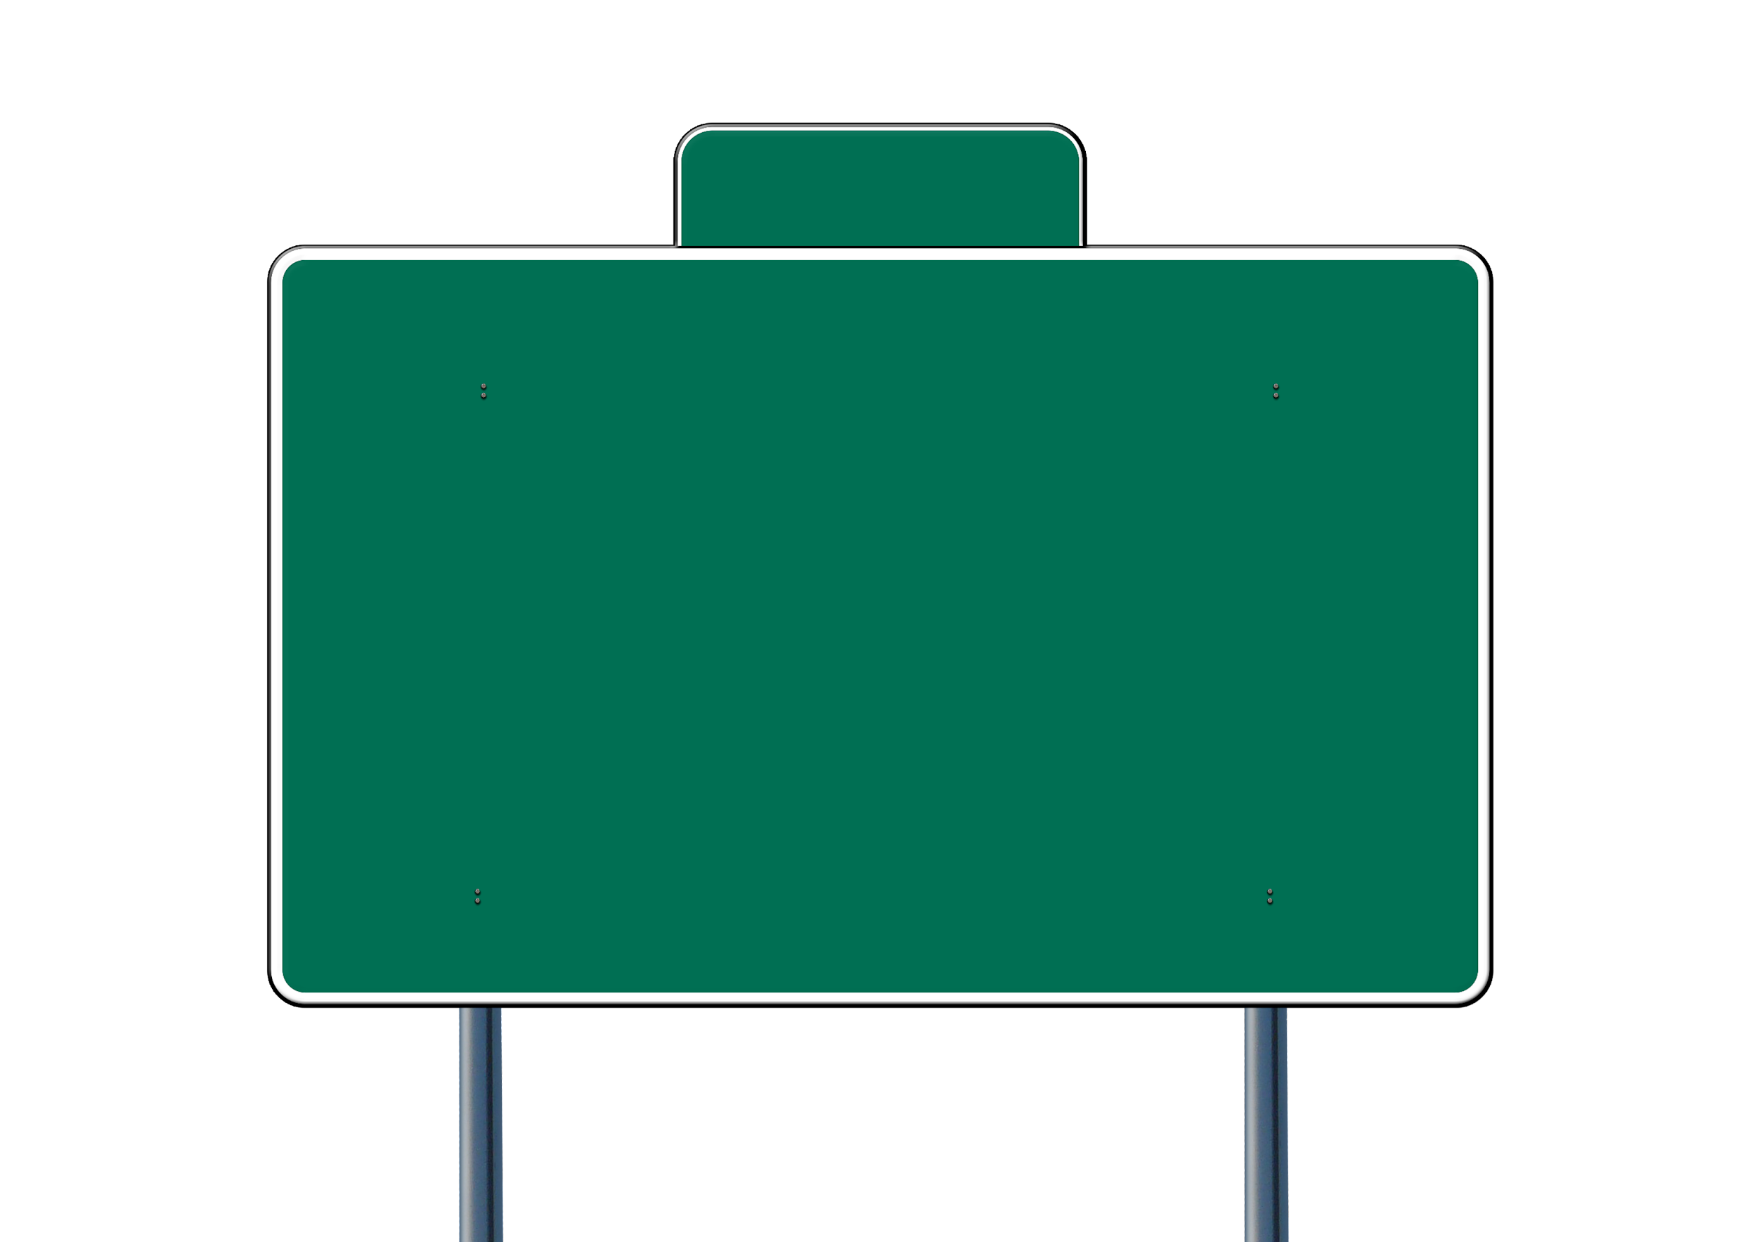

Read the Assignment Carefully
1
❕
1. What is the assigned format?
2. What is the objective of the paper?

Slide 3
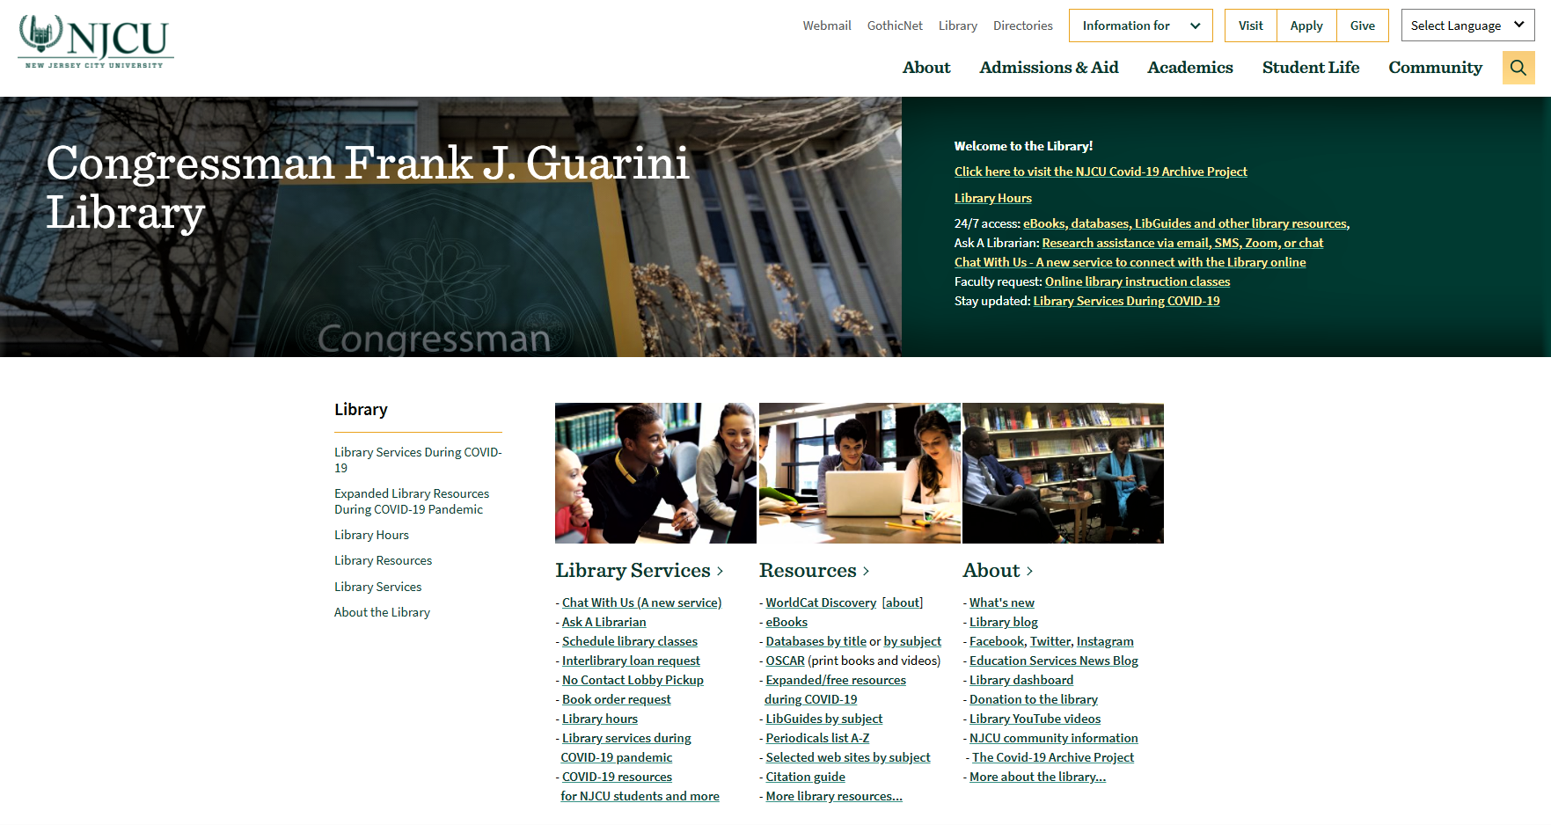
Gather Sources
2
https://www.njcu.edu/library

Slide 4
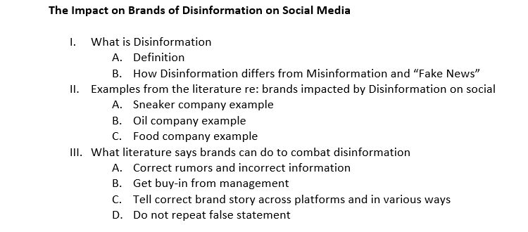
Outline or Mind Map Your Paper
3
OUTLINE how your paper will flow BEFORE you begin to write.
*
*Ex.1

Slide 5
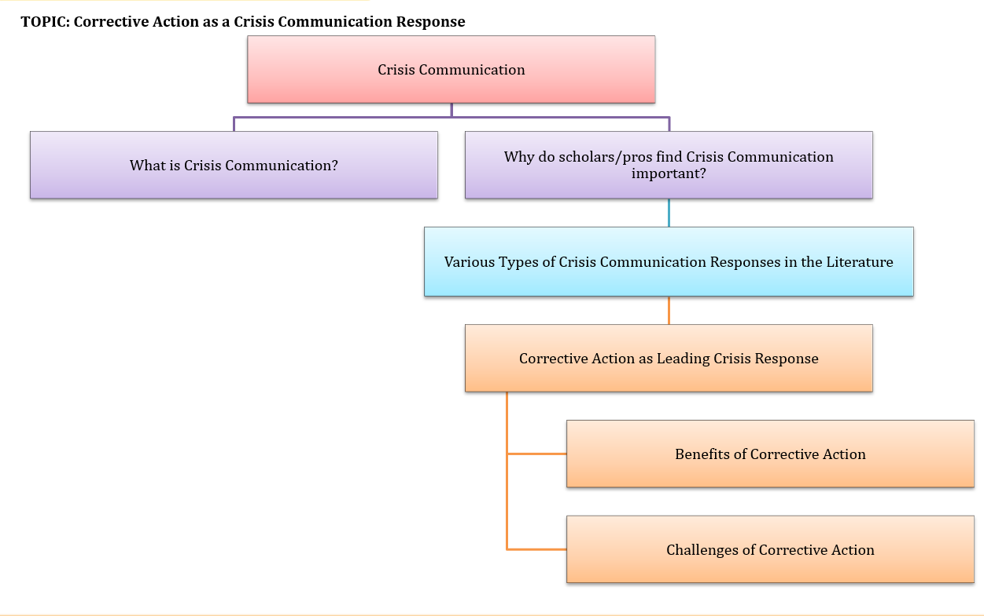

Outline or Mind Map Your Paper (cont.)
3
Remember, there is NO such thing as “writer’s block.” Rather, “writer’s block” means you have nothing to write about. Garbage in equals garbage out.
*Ex.2

Slide 6
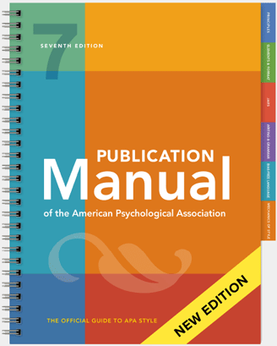

Know How to Cite Properly
4
To paraphrase: to express the meaning of the writer using DIFFERENT WORDS especially to achieve greater clarity.
If you do not remember how to use APA Style, see our “10 Minutes” PPT regarding APA.

Slide 7

Begin Draft ONE
5

Slide 8


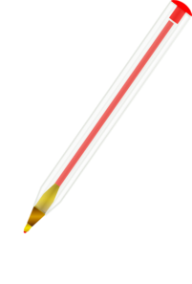
PRINT Draft ONE and READ it ALOUD
6
Edit as you read!

Slide 9

Edit and Add to Draft ONE to Create Draft TWO
7

Slide 10

REPEAT steps 6 and 7 as Needed
8
1) Follows the required assignment
2) Is in the right format/number of pages
3) Tells a logical story – meaning sentences and paragraphs flow well and make sense
4) Is in APA 7th edition
5) Is well edited

Slide 11

Print and Read a Final Time
9
Never hand in a paper you have not read – several times.
Remember To Read Aloud!

Slide 12

Deliver Your Paper
Hand in your paper as the assignment requires!
10

Slide 13

Good Luck!
NJCU Remote Writing Coaching
And…if you need more assistance, contact the Hub’s Remote Writing Coach:
Need a refresher on other key learnings? Check out our other videos in our “10 Minutes On” series, available on the Marketing Department Website:
https://www.njcu.edu/academics/schools-colleges/school-business/departments/marketing
https://www.njcu.edu/academics/resources-services/centralized-tutoring-and-academic-support-services/asynchronous-writing-coaching

Slide 14
Thanks!
Graphics Used:
Hands of character writing letter at desk with papers, pencil, envelopes and coffee cup. [Photograph]. (n.d.). Vector, Freepik.
Printers Cliparts #221879 [Photograph]. (n.d.). Collection of Printers Cliparts, Clipart Library.
RED BALLPOINT PEN CLIP ART [Photograph]. (n.d.). Clker.com.
[Photograph]. (n.d.). Https://take2.ie/about-us/.
Checklist Clipart [Photograph]. (n.d.). Checklist, Kissclipart.com.
Driver, M. (n.d.). Reading [Photograph]. Dribble.com.
[Photograph]. (n.d.). Real Estate Lineal Color Set icon set, Iconfinder.com.
Created by Maria Isabel Sanchez, Marketing Major, 2022 Graduate

