Slide 1

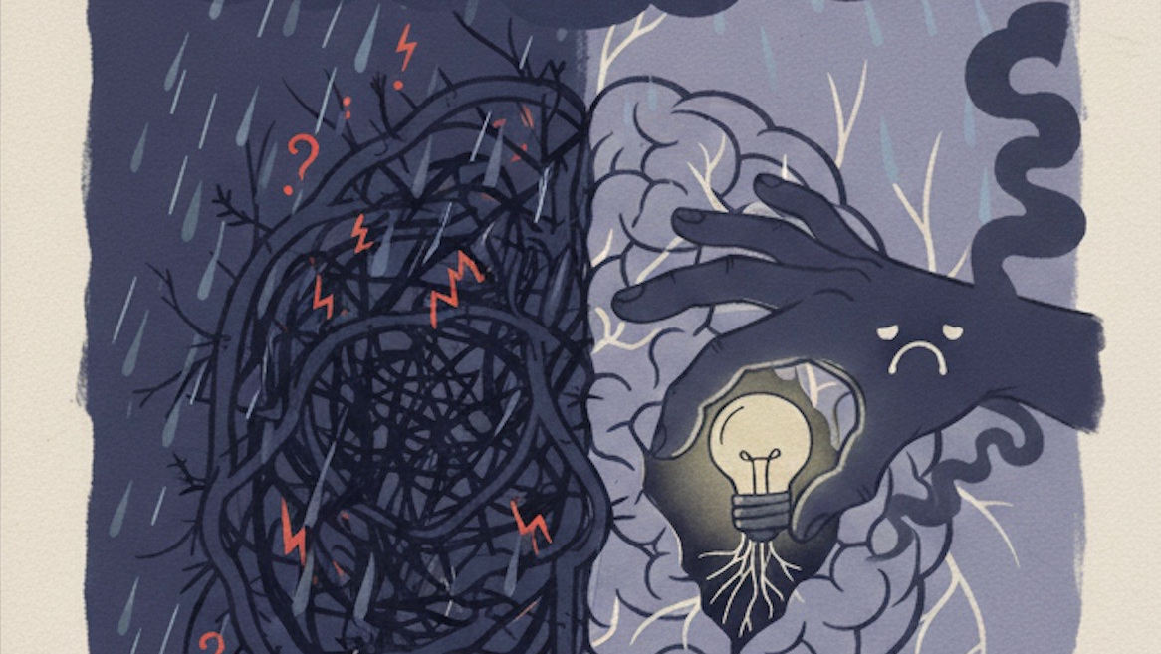
9th Annual NJCU Pedagogy Day
From Neurons to Narratives:
Motivation, Anxiety, and Teaching in the Brain-Aware Classroom
March 30, 2026
11.00 am – 2.00 pm | Hepburn Hall - Gothic Lounge
Pedagogy Planning Committee: Peri Yuksel (chair), Nic Zapparrata, Hilda Merchan, Mia Pepe

Slide 2
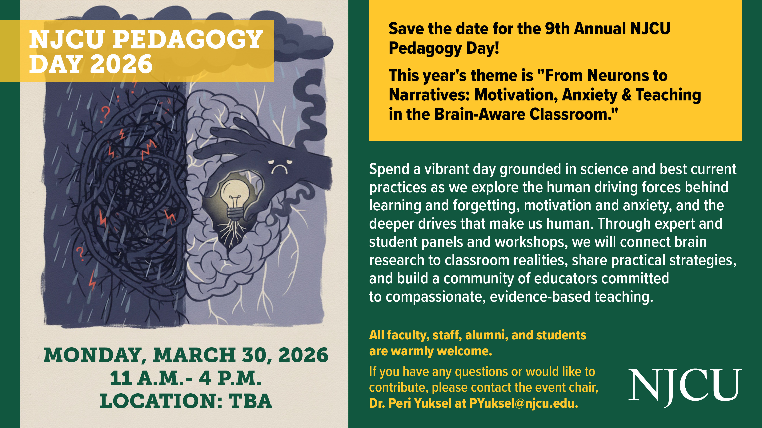
From Neurons to Narratives: Motivation, Anxiety, and Teaching in the Brain-Aware Classroom
Time | Session | Speaker(s)
11:00 AM | Opening | Dr. Peri Yuksel
11:20 AM | Tribute | Dr. Frank Nascimento
11:40 AM | Keynote | Dr. Carol Reed
12:00 PM | Panel | Dr. Dana Mason; Dr. Jennifer Pax; Dr. Muriel Rand; Dr. Christopher Shamburg
12:30 PM | Break
12:40 PM | Spark Talk | Dr. Linda Khatib
1:10 PM | Community Activity | Rachel Guanlao (NJCU alumna)
1:50-2.00 PM | Closing | Dr. Nic Zapparrata
“Weather Your Mind” Illustration by Hiya Patel

Slide 3
Welcome to the 9th NJCU Pedagogy Day ☺
Peri Yuksel, chair & organizer
From Neurons to Narratives: Motivation, Anxiety, and Teaching in the Brain-Aware Classroom
Since 2018, NJCU Pedagogy Day has brought together scholars, educators, students, and alumni for interdisciplinary dialogue on evidence-based teaching and learning practices—a tradition grounded in resilience, hope, and lifelong learning. Building on past themes that explored how we teach and learn in a distracted world and how innovation, AI, art, and advocacy can support mental health in education, the 9th Annual NJCU Pedagogy Day invites you into this year’s theme: “From Neurons to Narratives: Motivation, Anxiety & Teaching in the Brain-Aware Classroom.”
Join us for a vibrant day of keynote learning, panels, and hands-on workshops that connect brain research to classroom realities, sharing practical strategies while strengthening a compassionate community committed to helping learners thrive. Most importantly, we gather to celebrate what our educators and students have built together: the accomplishments, collaborations, and everyday teaching moments that create lasting impact across NJCU and beyond.

Slide 4
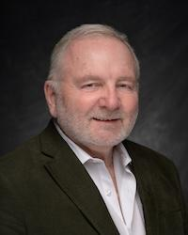
11:20am Tribute Address
“Standing on the Shoulders of a Giant: Celebrating Dr. Jim Lennon’s Legacy”
From Neurons to Narratives: Motivation, Anxiety, and Teaching in the Brain-Aware Classroom
James Lennon, Ph.D., has been a guiding force in the NJCU Psychology Department for decades: a mentor, colleague, and leader whose influence extends far beyond the classroom. As professor and chair, he inspired generations of students through his teaching in assessment, counseling, and consultation, modeling intellectual rigor, compassion, and ethical responsibility. A licensed psychologist and certified school psychologist, he brought deep clinical wisdom to his work and served as an expert witness in Family and Supreme Courts. Dr. Lennon’s legacy is defined not only by his scholarship on dyslexia and intimate partner violence, but by the integrity and humanity he brings to all he does. Join Dr. Nascimento in this tribute to offer deep gratitude for Dr. Lennon’s enduring impact and the foundation he built for our department and community to thrive.

Slide 5
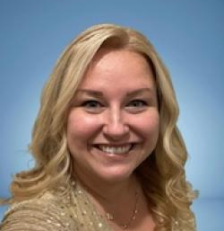
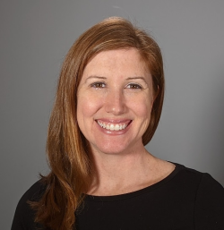
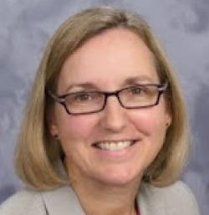
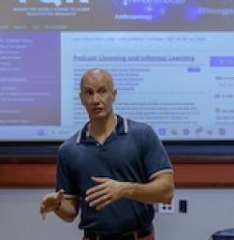
12.00 pm
Panel
“Leveraging Artificial Intelligence (AI) in Teaching and Learning for Positive Brain Development”
From Neurons to Narratives: Motivation, Anxiety, and Teaching in the Brain-Aware Classroom
NJCU faculty panelists Drs. Dana Mason, Jennifer Pax, Muriel Rand, and Christopher Shamburg examine the benefits and challenges of AI through the lens of neuroplasticity, which is the brain’s capacity to adapt across cognitive, psychological, and socio-emotional development. The panel will highlight how AI-supported teaching and learning can both strengthen and strain key outcomes such as motivation, mindset, self-efficacy, self-esteem, anxiety, and critical thinking. The pedagogy day audience will leave with a clear takeaway: a brain-based framework for evaluating AI tools and its applications.
Drs. Dana Mason, Jennifer Pax, Muriel Rand, Christopher Shamburg (clockwise from left)

Slide 6
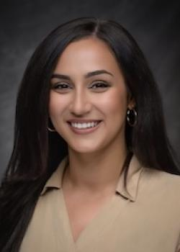
From Neurons to Narratives: Motivation, Anxiety, and Teaching in the Brain-Aware Classroom
12.40 pm
Spark Talk
“Learning with an Anxious Brain”
Linda A. Khatib, Psy.D. is a Licensed Clinical Psychologist and Assistant Professor of Psychology at NJCU. An NJCU alumna, she teaches primarily clinical psychology courses and is deeply committed to student mentorship and helping students build the skills and confidence needed for successful careers in psychology. Dr. Khatib completed her postdoctoral fellowship at the War Related Illness and Injury Study Center (WRIISC) at the VA New Jersey Healthcare System, where she focused on clinical care and research with Veterans with complex medical and mental health conditions.
Dr. Khatib brings a practical, brain-based perspective to managing anxiety in academic and everyday settings, with a focus on helping people learn, perform, and thrive despite an anxious brain.

Slide 7
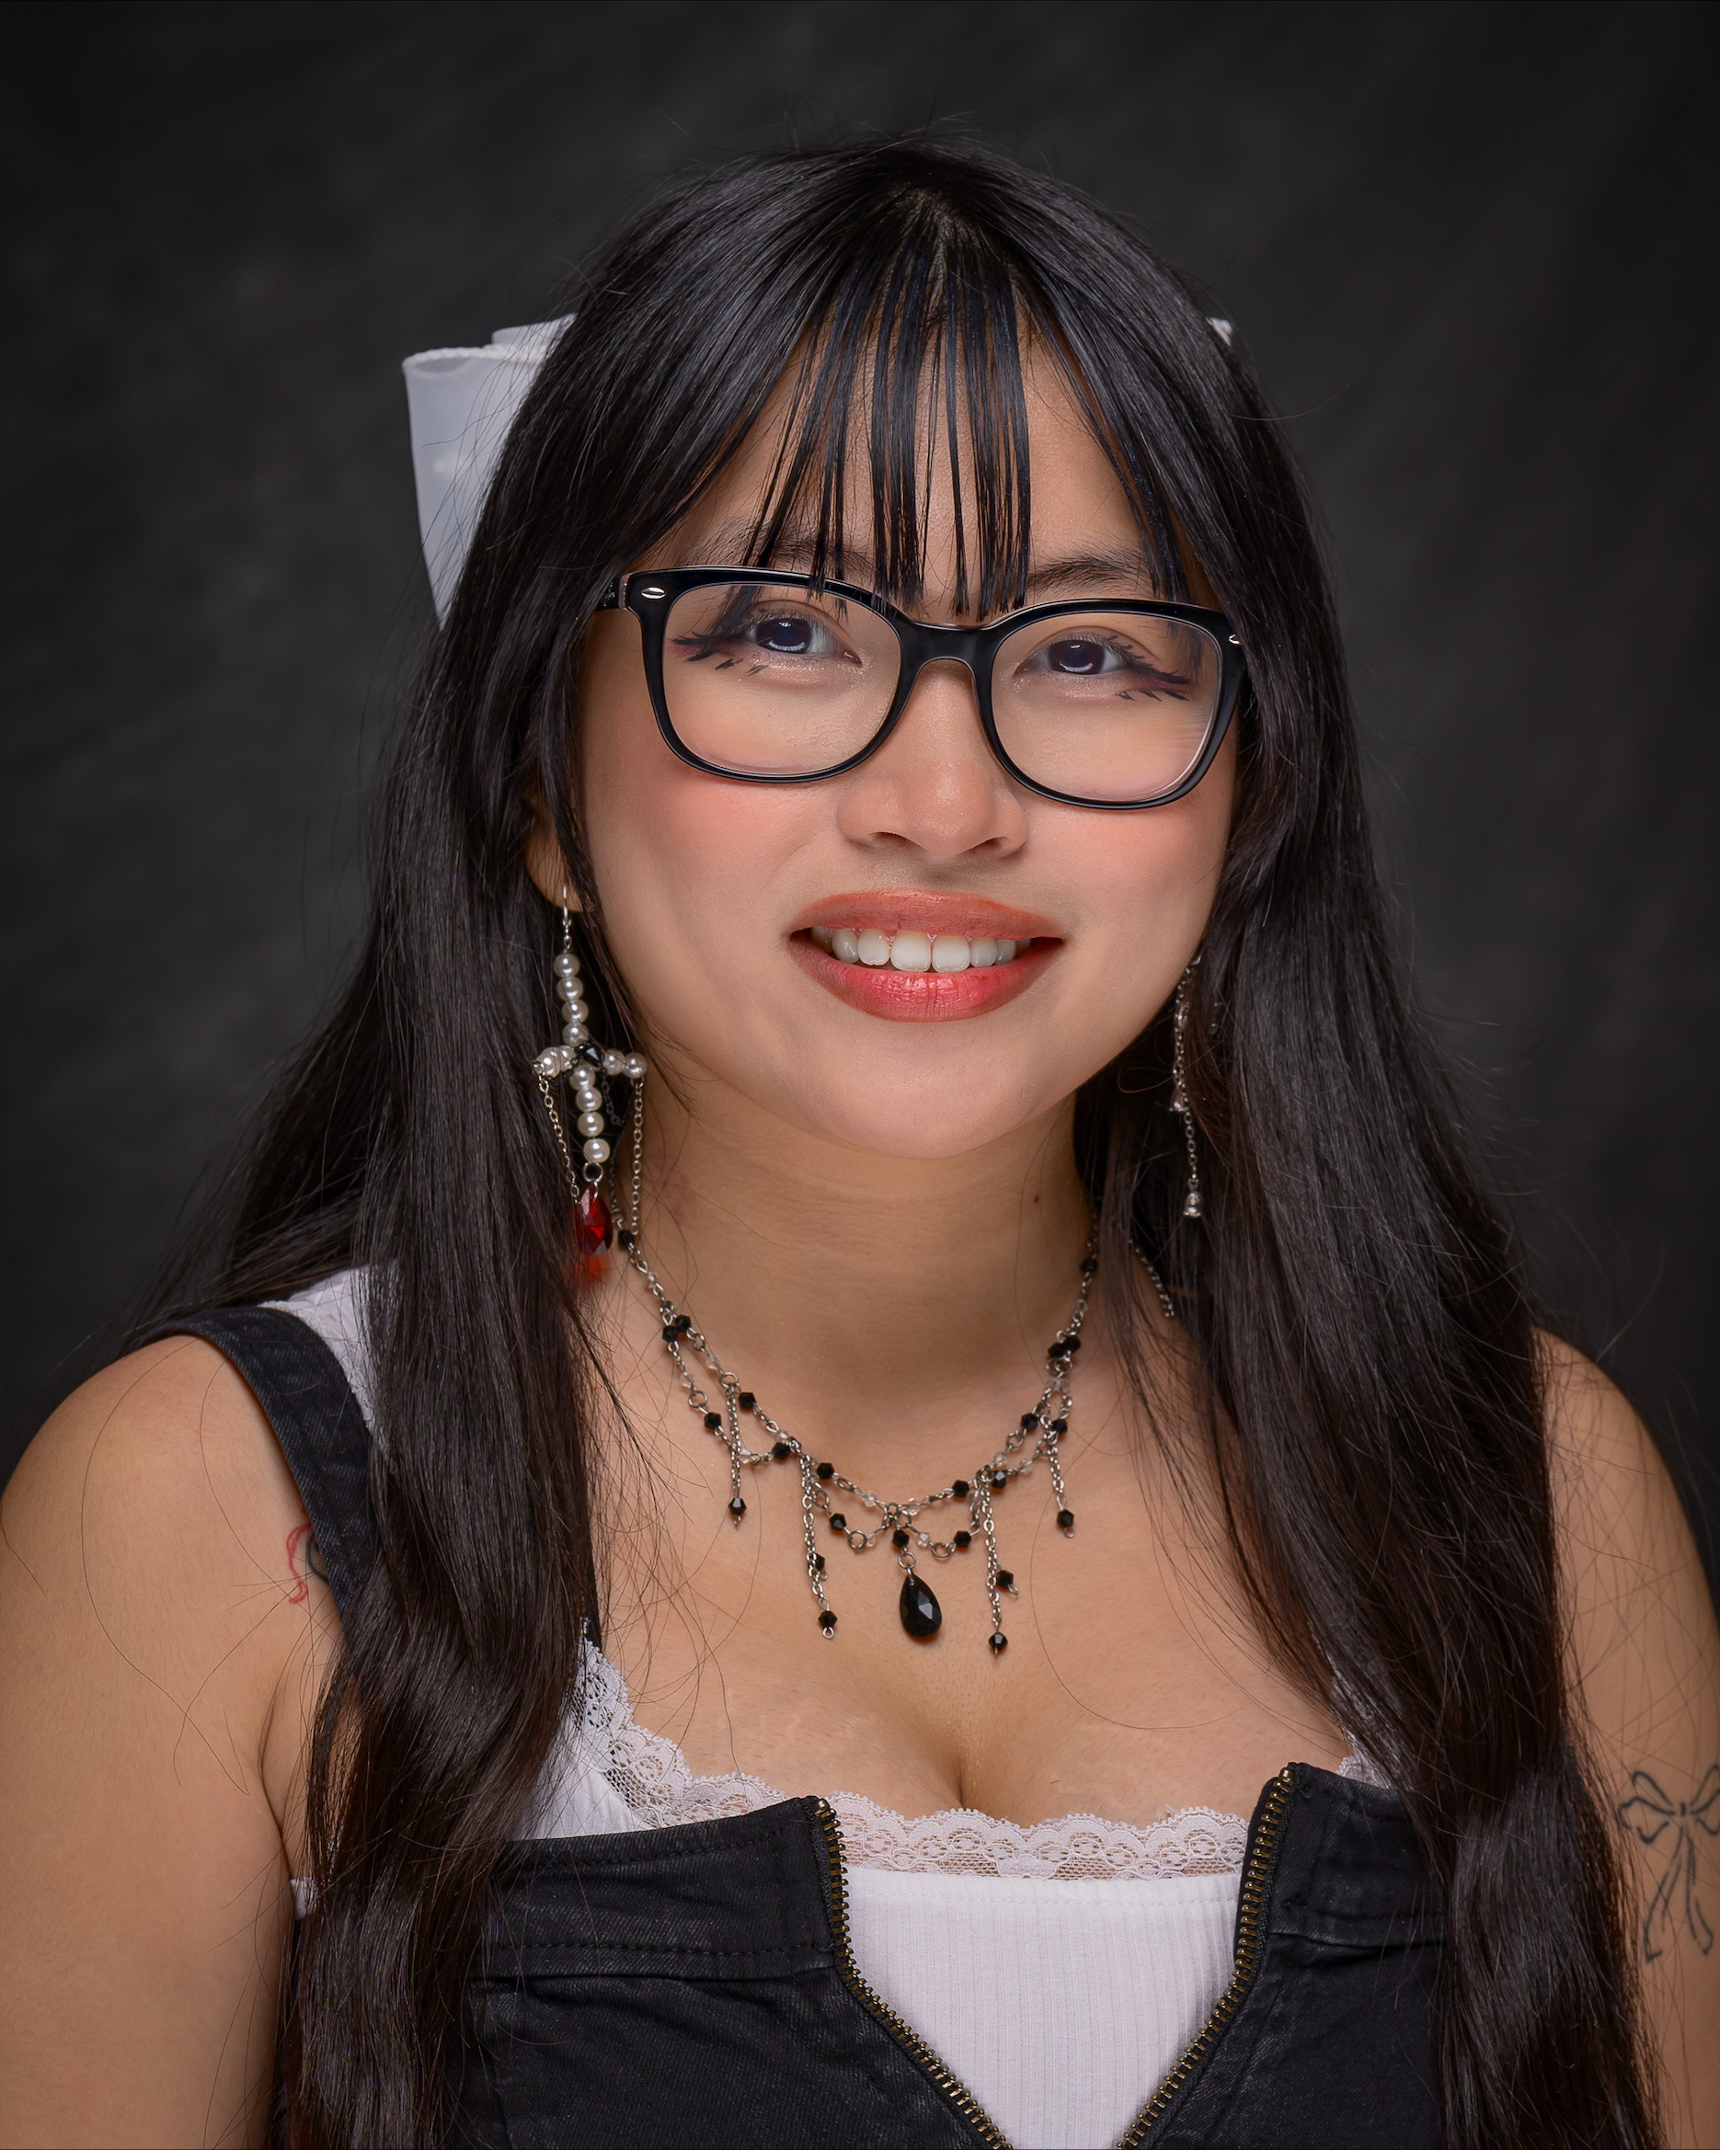
From Neurons to Narratives: Motivation, Anxiety, and Teaching in the Brain-Aware Classroom
1.10 pm
Community Workshop
“Origami”
Rachel Guanlao is an NJCU alumna who earned her B.A. in Psychology and Sociology. Currently, Rachel is a Clinical Candidate at Kean University’s School and Clinical Psychology Psy.D. program.
Due to popular request, we are excited to welcome her back for Pedagogy Day 2026 to share her love of teaching origami. For Rachel, origami is a hands-on reminder that the skills we build cognitively can be practiced in a tactile, meaningful ways and that life’s “folds” and changes don’t have to stop us from transforming into something new. As a bonus, each creation becomes a small, beautiful gift we can share with the people we care about.

Slide 8
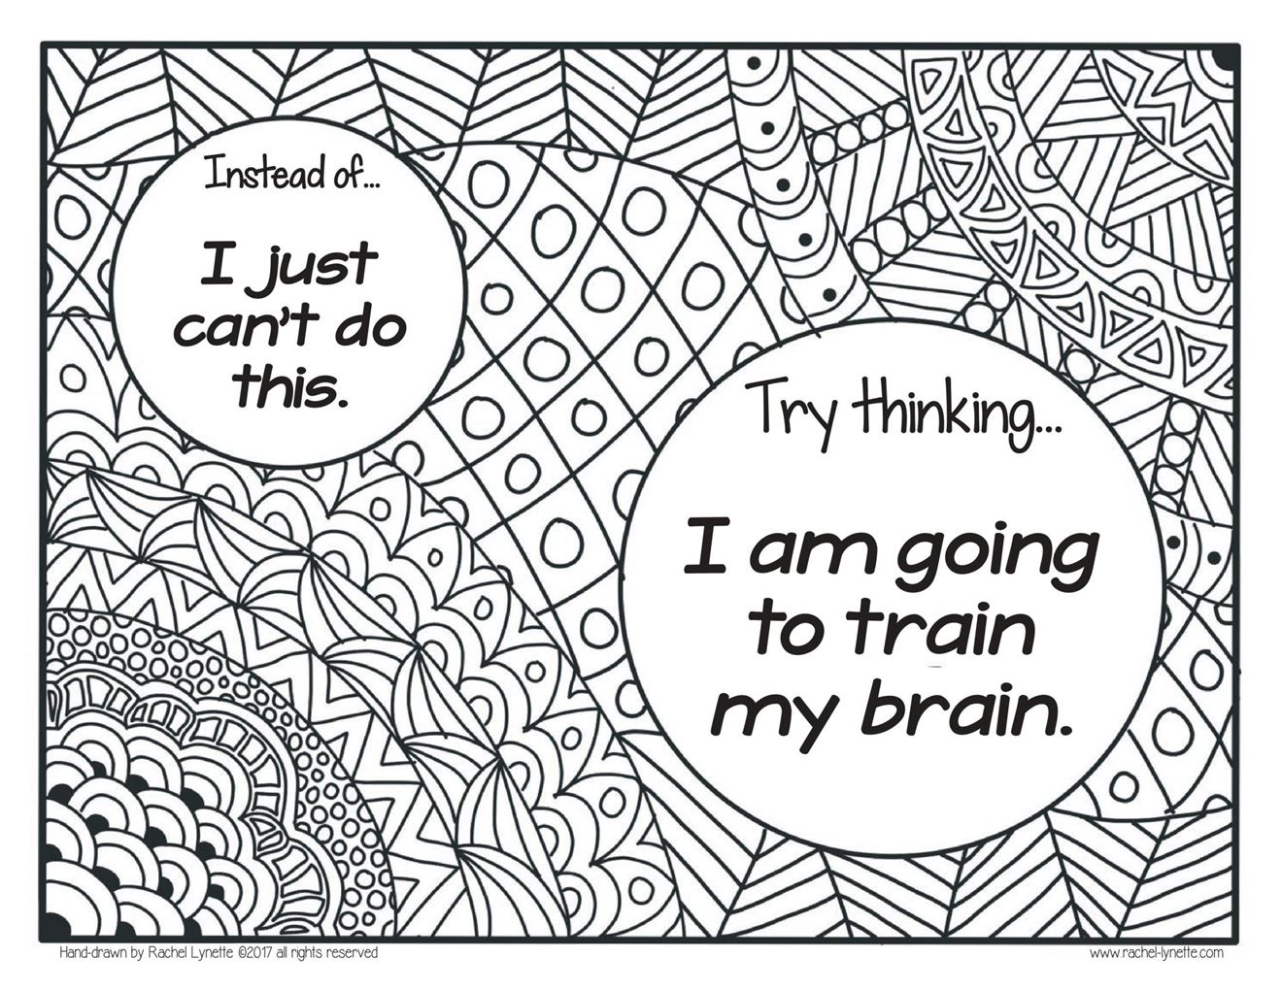
9th Annual NJCU Pedagogy Day:
From Neurons to Narratives: Motivation, Anxiety, and Teaching in the Brain-Aware Classroom
Closing Speech
Dr. Nic Zapparrata

Slide 9
“Weather Your Mind” Illustration by Hiya Patel
Thank you!
Pedagogy Planning Committee: Peri Yuksel (chair), Nic Zapparrata, Hilda Merchan, Mia Pepe

