Slide 1

The Deborah Cannon Partridge Wolfe College of Education New Jersey City University
Center for Teacher Preparation & Partnerships
Clinical Practice I Orientation

Slide 2
CTPP CONTACT INFORMATION
Location: Professional Studies Building, Room 203A
Hours: 9:00 a.m. – 5:00 p.m.- Monday through Friday
Office Telephone: (201) 200-3015 - Fax: (201) 200-2334
Certification Questions Call: (201) 200-2079
EMAIL: ctppcert@njcu.edu
CTPP Staff :
Brandi Warren, Director- bwarren@njcu.edu
Cynthia Vazquez , Assistant Director & Certification Administrator - cvazquez@njcu.edu
Jeanne Beckner, Administrative Assistant - jbeckner@njcu.edu
Denise Colon, Administrative Assistant – dcolon1@njcu.edu
Please visit the College of Education Facebook page.
Please follow us on Twitter.
www.njcu.edu/ctpp

Slide 3
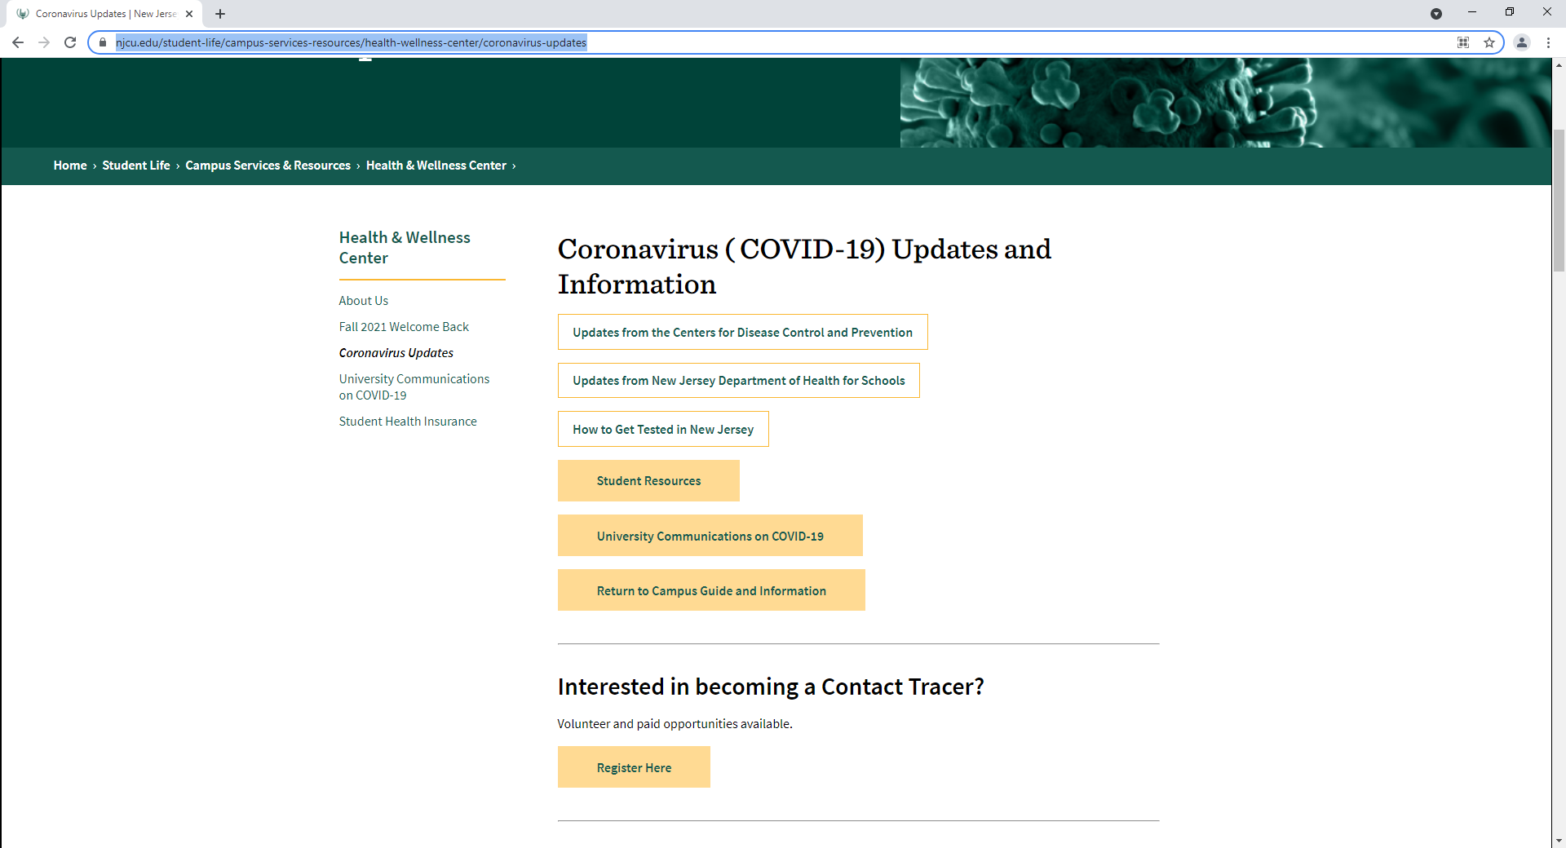
NJCU COVID INFORMATION https://www.njcu.edu/student-life/campus-services-resources/health-wellness-center/coronavirus-updates

Slide 4
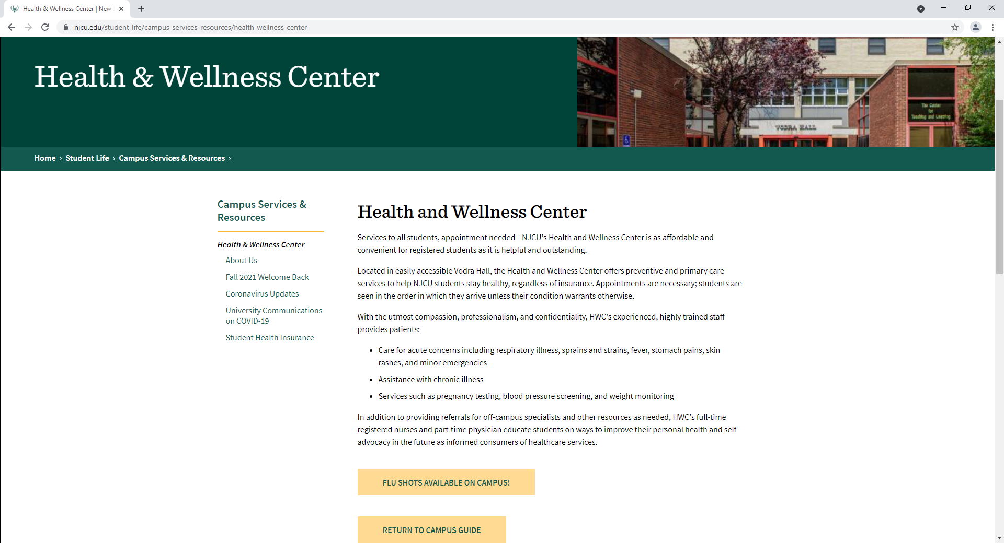
NJCU COVID INFORMATION https://www.njcu.edu/student-life/campus-services-resources/health-wellness-center

Slide 5
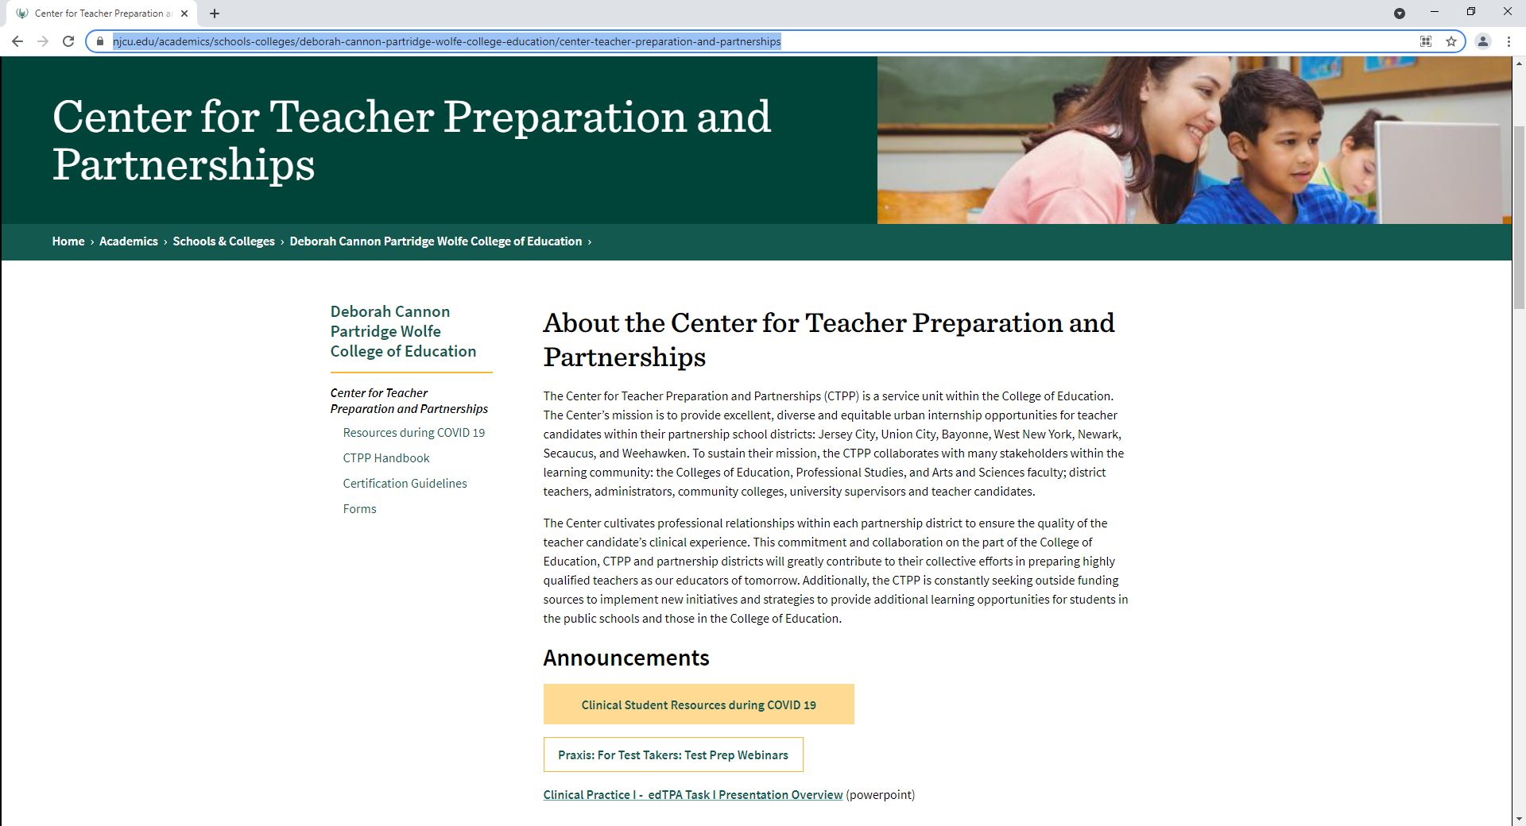
Center for Teacher Preparation & Partnerships https://www.njcu.edu/academics/schools-colleges/deborah-cannon-partridge-wolfe-college-education/center-teacher-preparation-and-partnerships

Slide 6
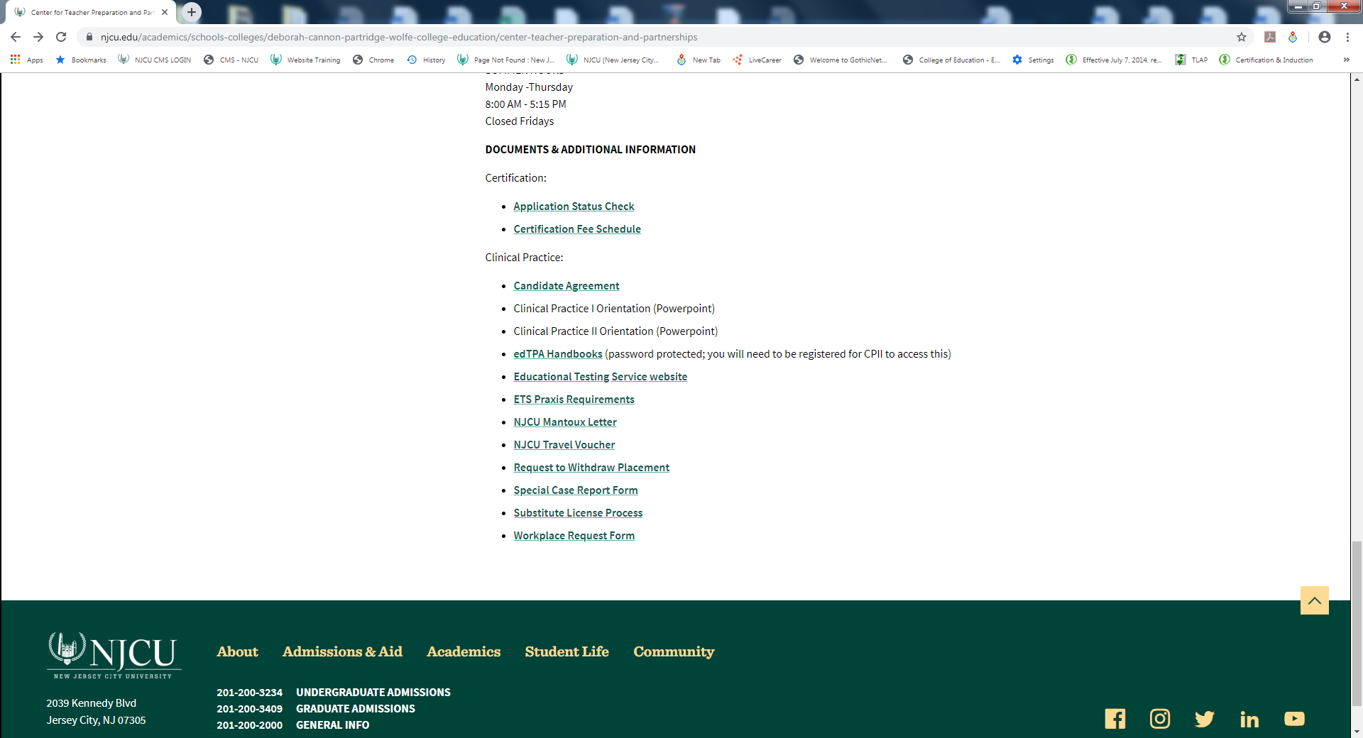

Slide 7
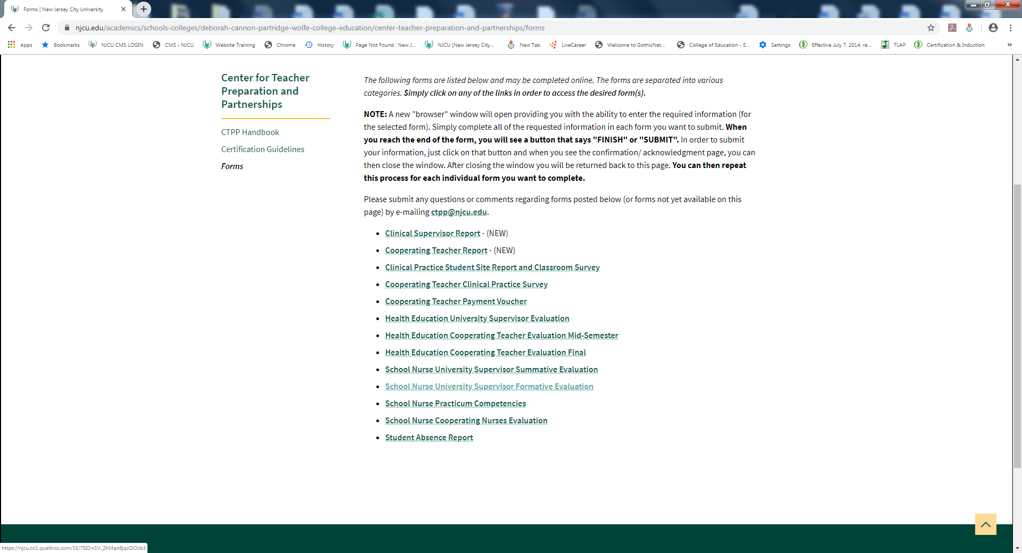

Slide 8
Practicum & Internship Language Revision
The new terminology is as follows:
Practicum – Clinical Practice I
Internship – Clinical Practice II
Practicum & Internship students-Clinical Interns
University Supervisors – Clinical Supervisors

Slide 9
Clinical Practice Application Information
Spring 2022
CP II CLEARANCE FORM IS DUE BY– November 1, 2021
*Paper applications are no longer available*
Clinical Practice I fee - $65
Clinical Practice II fee - $150
*Fees will be added to your tuition bill*
Praxis Subject Assessment Scores are due by – November 15th , 2021
*Please note: You must ensure that the NJDOE is the recipient of your Praxis score report*
*Required to confirm your CPII Placement*
Please make sure you keep a complete copy of your Praxis Score Report when submitting your clearance form.
*Please Note*
No Intern will continue to Clinical Practice II without submitting a passing Praxis score report.

Slide 10
Clinical Practice I & Clinical Practice II Important Dates & Policies
Practicum meets
Fall 2021
Clinical Practice I
Meets 1 and ½ days for 15 weeks
(9/8/2021 – 12/15/2021)
Be sure to submit your passing Praxis SUBJECT ASSESSMENT SCORES BY THE NOVEMBER 15TH DEADLINE!

Slide 11
Evaluation Process
You will be assigned a university supervisor by your department chairperson
Your supervisor will contact you prior to observing and evaluating you in the classroom.
Following the supervisor’s observation, he or she will conference with you, and review the evaluation. Once the evaluation has been submitted, you will have access in TK20.
Clinical Practice I (Undergraduate) :
Your supervisor will visit you during your clinical practice I - four times.
The first visit is solely to ensure that you have been placed in an appropriate classroom setting according to your area of study.
Four evaluations will also be conducted.
Clinical Practice II:
Your supervisor will observe you on the average of every other week, submitting
seven formative evaluations and a final or summative evaluation, indicating a pass or fail grade.
Your cooperating teacher will submit an on-line mid-semester evaluation and final evaluation.
Interns will have immediate access to evaluations submitted in Tk20.
Ask your supervisor to share with you the evaluation form they will be using.

Slide 12


Evaluation Process continued…
Effective Fall 2017,
all teacher candidates must complete edTPA.
This is a mandatory NJ DoE requirement (no exemptions).
Students are responsible for the $300 fee.
This performance assessment involves video recording, lesson analysis and external evaluations.
Planning Session attendance is REQUIRED!

Slide 13

Planning for edTPA: A Workshop Series for Clinical Practice I Interns
All sessions will be held via ZOOM from 12PM – 2PM
Attendance is REQUIRED;
Please SAVE THESE DATES!!!
Forward your questions to edtpa@njcu.edu.
Friday, September 10th
Friday October 1st
Friday October 29th
Friday November 19th
Notes:
Notes to presenter:
Description of what you learned in your own words on one side.
Include information about the topic
Details about the topic will also be helpful here.
Tell the story of your learning experience. Just like a story there should always be a beginning, middle and an end.
On the other side, you can add a graphic that provides evidence of what you learned.
Feel free to use more than one slide to reflect upon your process. It also helps to add some video of your process.

Slide 14
…Important Forms
Withdrawal Form
If you plan to withdraw you must first contact the CTPP Department.
Submit a completed withdrawal form in the CTPP (form is available on the CTPP website).
Apprise yourself of the registrar’s withdrawal policies and deadlines.
Special Case Report Form
Once identified, challenges during the clinical component are outlined in a Special Case Report and addressed during a special case meeting.
Absence Form and Policy Form & Policy
Clinical Practice I interns are allowed to be absent ONCE.
Clinical Practice II interns are allowed to be absent three times.
Acceptable reasons for absences are for illness or death in the family
If you are going to be absent you must:
1- Inform the school : (The cooperating teacher and the main office)
2-Call the clinical supervisor
3-Fill out a student absence form located on the CTPP website

Slide 15
Clinical Policies
Students will be given two opportunities to be successful in
Clinical Practice I or Clinical Practice II
This applies whether the two opportunities take place in the same semester or two different semesters. The timeline for the second placement will be determined by the department chairperson and director of the CTPP.
If the second opportunity takes place in a subsequent semester, a new application must be submitted to the CTPP.
The student will be responsible for paying the tuition as well as the Clinical Practice I or Clinical Practice II fee, and registering for any co-requisite courses needed.
All Policies and forms can be viewed on the CTPP website
www.njcu.edu/coe/ctpp

Slide 16
IMPORTANT WEBSITE LINKS
New Jersey Department of Education
http://www.state.nj.us/education/educators/license/
Customer Service : (609) 292-2070.
Monday through Friday (except major holidays)
PRAXIS TEST INFORMATION
www.ets.org - (800) 772 9476

Slide 17
CTPP CERTIFICATION PROCESS
Undergraduate Certification Applications
To be submitted in the Graduation Clearance office
The Office of Undergraduate Clearance will forward the UG certification applications to the CTPP toward the end of : January, June and August.
Dates for application delivery are decided by the Office of Undergraduate Clearance each semester.
Graduate Certification Applications
To be submitted in the CTPP department
Certification application directions with a link can be requested by emailing ctppcert@njcu.edu .
All graduate certification applications with supporting documentation can be forwarded to gradcert@njcu.edu.
Please Note:
If you have an academic or financial hold, the official transcripts will not be forwarded by the registrar which will prevent your application from being processed.

Slide 18
CTPP CERTIFICATION PROCESS Continued….
Payment Receipt
Graduate Students:
A receipt for your on-line payment will be forwarded to your email.
REFUNDS
If you require a refund, please email the ctpp with your name, student ID, the amount paid and the CTPP will submit a refund on your behalf.

Slide 19
CTPP CERTIFICATION PROCESS Continued….
Please allow TWO - THREE full months for processing
Applications begin processing at the end of each month.
For example, an application submitted on the 1st of the month to the CTPP will begin to be processed on the last weekday of the month.
PLEASE KEEP IN MIND:
MAY graduates – The grades will not post to the official transcript until end of June
DECEMBER graduates- The grades will not be posted to the official transcript until end of January
The CTPP CAN NOT begin to process your certification application if:
- Paperwork is incomplete
- If you have failed any required state exam or assessment
-Final grades have not been posted to the official transcript
- If there is a hold on your transcript (i.e. : academic or financial hold)
Pending approval, your application will be forwarded to the state and an e-mail will be sent to you using the contact information provided on your certification application

Slide 20
EXCELLENCE
PERFORMANCE
DEMEANOR
ATTIRE
Relationships

Slide 21

The Positive Teacher Pledge
I pledge to be a positive teacher and positive influence on my fellow educators, students and school.
I promise to be positively contagious and share more smiles, laughter, encouragement and joy with those around me.
I vow to stay positive in the face of negativity.
When I am surrounded by pessimism, I will choose optimism.
When I experience a challenge, I will look for opportunity to learn and grow and help others grow.
When faced with adversity I will find strength.
When I experience a set-back I will be resilient.
When I meet failure, I will fail forward and create a future success.
I believe my best days are ahead of me, not behind me.
I believe I'm here for a reason and my purpose is greater than my challenges.
I believe that being positive not only makes me better it makes my students better.
So today and every day I will be positive and strive to make a positive impact on my students, my school and the world.
By Jon Gordon

