Slide 1
Backward Course Design: An Introduction
Christine Harrington Ph.D. Associate Professor and Co-Coordinator, Ed.D. in Community College Leadership Program
New Jersey City University

Slide 2
Course Design Frameworks
Coverage-Based Design
Activity Based Design
Wiggins & McTighe’s Backward Design

Slide 3
Backward Design
Desired Results
Learning Outcomes
Evidence
Formal
Learning Experiences and Instruction
Teaching Methods
Informal

Slide 4

Backward Design is Based on:

Slide 5
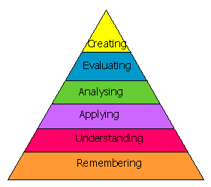
Bloom’s Taxonomy of Educational Objectives

Slide 6


Course Design During a Pandemic
Step 1: Learning Outcomes

Slide 7

Course Design During a Pandemic
Step 2: Evidence
May need to get creative!
Explore online tools
Consult with colleagues

Slide 8

Course Design During a Pandemic
Step 3: Teaching
Synchronous and Asynchronous Lessons
Examples and Resources
Feedback Opportunities

