Slide 1
The Deborah Cannon Partridge Wolfe College of Education New Jersey City University
Center for Teacher Preparation & Partnerships
Clinical Practice II Orientation

Slide 2
CTPP CONTACT INFORMATION
Location: Professional Studies Building, Room 203A
Hours: 9 a.m. – 5:00 p.m.- Monday, Wednesday - Friday
Office Telephone: (201) 200-3015 Fax: (201) 200-2334
Certification : (201) 200-2079
Brandi Warren, Director bwarren@njcu.edu
Cynthia Vazquez , Assistant Director /Certification Administrator
cvazquez@njcu.edu or ctppcert@njcu.edu
Administrative Assistant
Jeanne Beckner, jbeckner@njcu.edu
Please visit the College of Education Facebook page and follow us on Twitter.
www.njcu.edu/ctpp

Slide 3
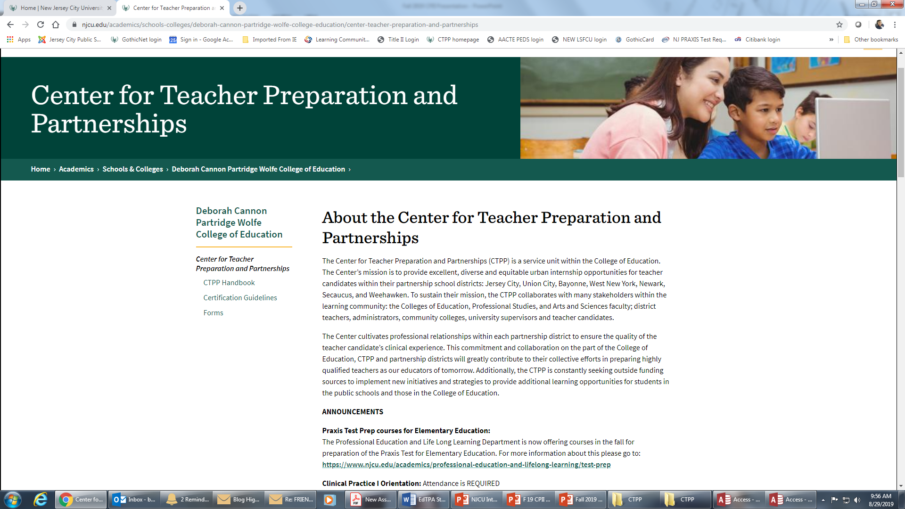

Slide 4
N J C U College of Education Claims
Claim 1
Our candidates know the subject matter they plan to teach
Claim 2
Our candidates demonstrate their pedagogical knowledge, integrating their understanding of their pupils’ developmental levels, individual differences, learning exceptionalities and socio-cultural backgrounds.
Claim 3
Our candidates demonstrate effective instruction, caring behavior and reflection to improve practice.
Claim 4
Our candidates know and value how individuals are shaped by their life experiences as mediated by factors such as social class, gender, race, ethnicity, language, sexual orientation, age and social needs. Our candidates know, value and engage in culturally responsive teaching to promote social justice, particularly in our urban areas.
Claim 5
Our candidates are able to use appropriate technology in carrying out their professional responsibilities.

Slide 5
NJ DOE CLINICAL COMPONENT CHANGES
Students graduating after September 1, 2016
need to achieve a minimum cumulative GPA of 3.00.
3.0 GPA
Entrance Exam (Praxis CORE)
Licensure Exam (Praxis Subject Assessment)
Performance Assessment (edTPA)
Practicum Clinical Practice I | Internship Clinical Practice II
Practicum & Internship students – Clinical Interns | University Supervisors – Clinical Supervisors

Slide 6
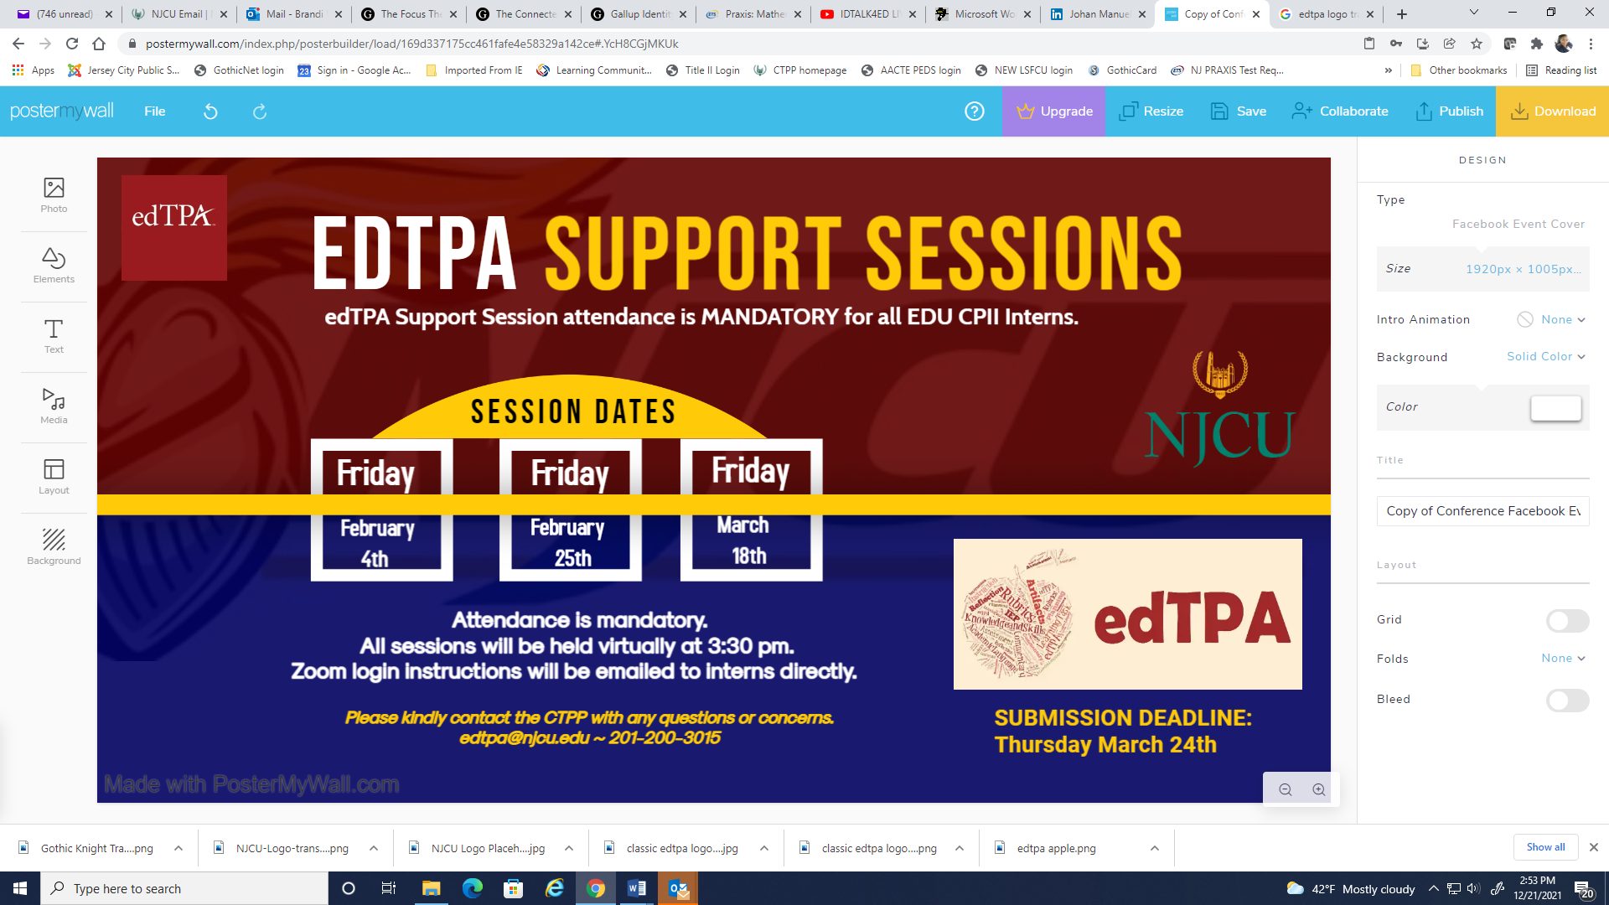

Slide 7
edTPA Submission and Scoring Timeline
Thursday March 24th
Thursday April 14th
RESUBMIT
April 21st or May 5th

Slide 8
…Important Policies
COVID Vaccination: NJ Executive Order 253 requires all P-12 school personnel to be fully vaccinated by October 18, 2021.
Withdrawal
Contact the CTPP if you plan to withdraw from clinical practice.
Apprise yourself of the registrar’s withdrawal policies and deadlines.
Attendance and Punctuality Form & Policy
Clinical Practice II interns are allowed to be absent three times for reasons such as
illness. Any additional absences MUST be made up.
Absentee protocol:
Inform the school, inform your clinical supervisor & submit an absence form.
Special Case Report
Significant clinical challenges are outlined in a Special Case Report and addressed during a special case meeting.
Special Case Outcomes
Each intern is given two opportunities to successfully complete clinical practice.
When clinical practice is postponed, the intern must reapply. Interns are
responsible for additional tuition, fees, and course registration.
Clinical practice may also be extended as a result of a Special Case Report.

Slide 9
Evaluation Process
Spring 2022 Clinical Practice II Interns report daily for 15 weeks
(Tuesday, January 18th – Friday, May 6th)
Clinical supervisors will contact interns during the first week of CPII.
Clinical supervisors schedule biweekly observations and evaluations in advance (minimum 7 evaluations: virtual and in person).
Interns receive seven formative evaluations and one summative evaluation with a pass or fail grade.
Each evaluation will be submitted in TK20 (immediate access).
Each observation should be followed by a post conference.
Your cooperating teacher will submit two evaluations: an on line mid-semester evaluation and a final evaluation. Attendance and punctuality will be reported in these evaluations, which are to be submitted in TK20.

Slide 10
Evaluation Access
Clinical Intern Self & Site Report
Cooperating Teachers Link
edTPA
Tk20Contact Info
tk20help@njcu.edu
ehickey@njcu.edu

Slide 11
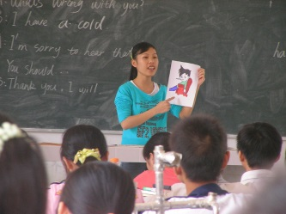
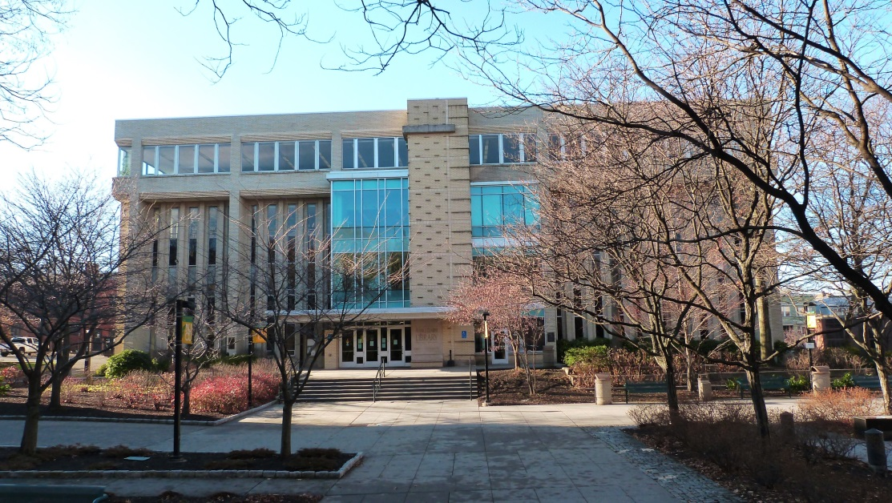
PRE-SERVICE TEACHERS
GET WHAT YOU NEED AT THE
CONGRESSMAN FRANK J. GUARINI LIBRARY
Contact the Education Services Librarian,
Juan Almodovar (jalmodovar@njcu.edu)

Slide 12
CTPP CERTIFICATION PROCESS
Undergraduate Students Applications are submitted in Undergraduate Clearance Applications forwarded in January, June, and August Grade changes/transcript adjustments may delay application processing. | Graduate Students Paper applications are available in the CTPP. Contact the CTPP for the link to the electronic application. Completed applications are submitted in the CTPP. Application fee can be paid online.
The application processing timeline is THREE FULL MONTHS.
ALL applications must have the payment receipt attached.
Requests for fee refunds must be e-mailed to ctppcert@njcu.edu.
Applications cannot be processed until all supporting documents are attached.
May graduates June | December graduates January | Summer graduates August

Slide 13
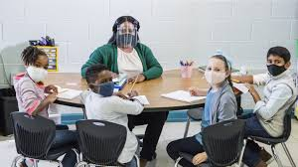
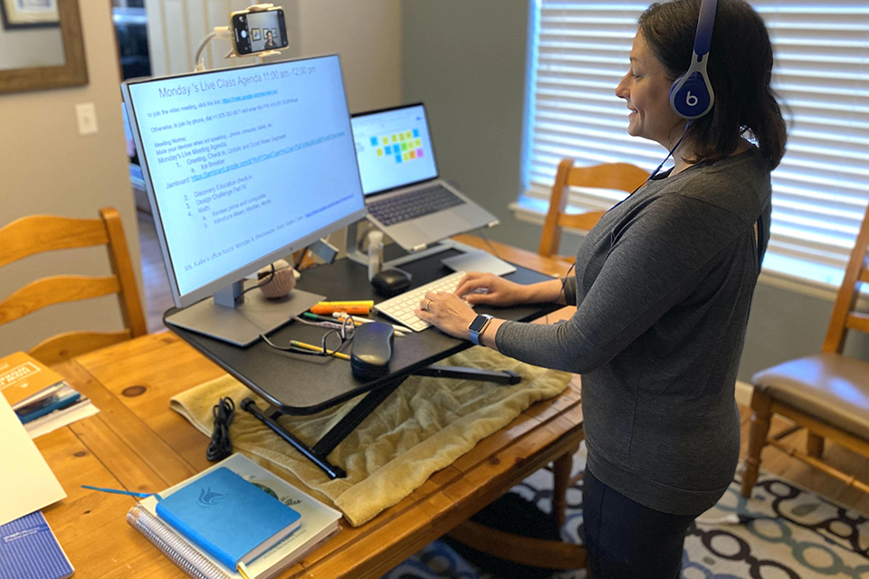
Life After Omicron… COVID Challenges and Changes

Slide 14
At NJCU, Excellence is the Standard
Performance
Demeanor
Relationships

Slide 15
“Whether you think you can, or you can’t… you’re right.” ~ Henry Ford
“The influence of a good teacher can never be erased.”

