Slide 1
Office of Research GRANTS and Sponsored Programs
Enhance university research footprint by strategic planning, training and awareness
The Mission of the Office of Research is to work with faculty, staff and students to foster and encourage the highest quality research and creative activities through
Developing and maintaining a culture and infrastructure that supports research/creative activities university-wide, promotes protection of human and animal subjects, and maintain research integrity
Facilitating these activities by helping investigators identify and obtain the resources they need to succeed
Promoting high ethical standards and compliance with applicable policies and guidelines of partners, the university, and the state and federal governments
Educating constituency regarding opportunities, procedures, and rules/guidelines in the performance and reporting of research
Helping investigators navigate regulatory hurdles and roadblocks
Promoting collaborative and innovative research programs that advance knowledge and address regional, national and global societal needs

Slide 2
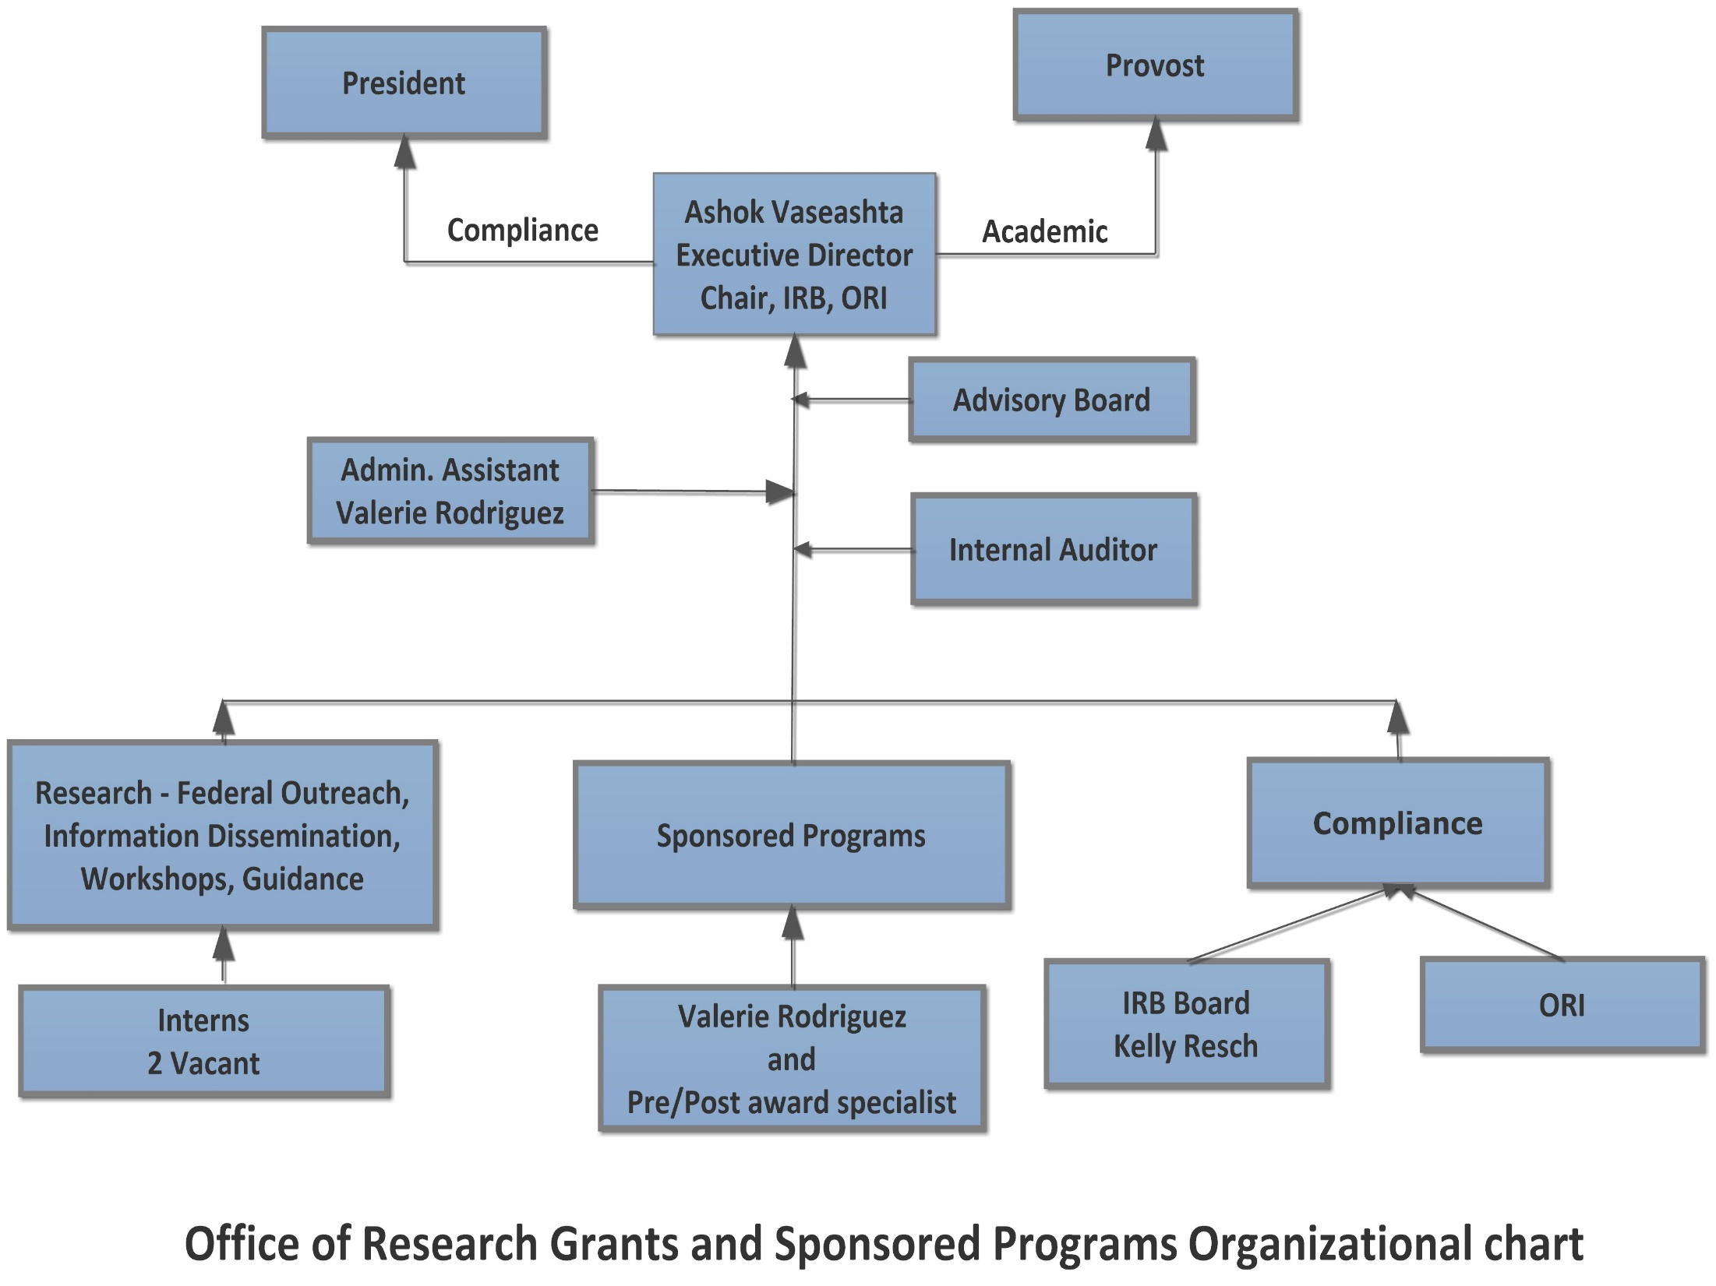

Slide 3

Office of Grants, Research and Sponsored Programs
Enhance university research footprint by strategic planning, training, workshop and awareness
Provide guidance/support to researchers in seeking and securing external grants and contracts
Compliance
IRB
ORI
Priorities identified in Strategic Plan and envisioning beyond
Transforming Lives

Slide 4
Objective
Provide a brief overview of IRB
Convey the application process
Alignment of expectations (due to exponential increase in capacity notwithstanding limited bandwidth)
Outline of review timeline

Slide 5
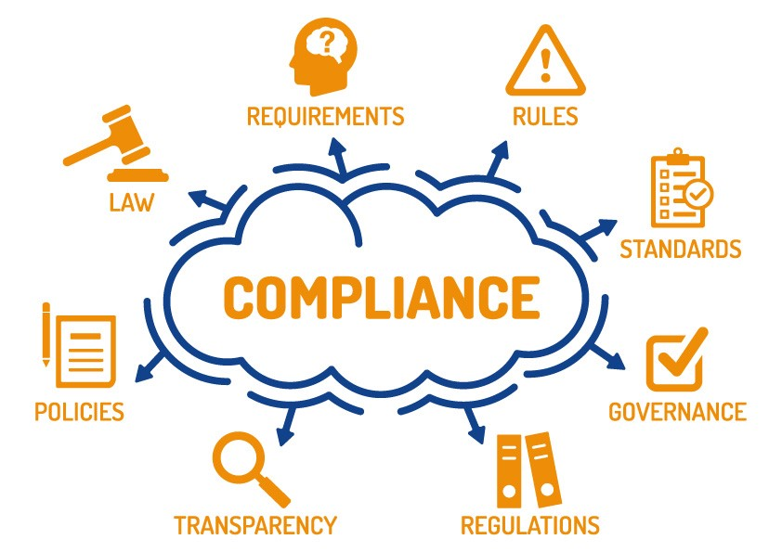

Slide 6
Office of Research Integrity
ORI carries out its responsibility by:
Developing policies, procedures and regulations related to the detection, investigation, and prevention of research misconduct and the responsible conduct of research;
Reviewing and monitoring research misconduct investigations conducted by applicant and awardee institutions, intramural research programs, and the Office of Inspector General in the Department of Health and Human Services (HHS);
Recommending research misconduct findings and administrative actions to the Assistant Secretary for Health for decision, subject to appeal;
Assisting the Office of the General Counsel (OGC) to present cases before the HHS Departmental Appeals Board;
Providing technical assistance to institutions that respond to allegations of research misconduct;
Implementing activities and programs to teach the responsible conduct of research, promote research integrity, prevent research misconduct, and improve the handling of allegations of research misconduct;
Conducting policy analyses, evaluations and research to build the knowledge base in research misconduct, research integrity, and prevention and to improve HHS research integrity policies and procedures;
Administering programs for: maintaining institutional assurances, responding to allegations of retaliation against whistleblowers, approving intramural and extramural policies and procedures, and responding to Freedom of Information Act and Privacy Act requests.

Slide 7

Institutional Review Board (IRB)
Office for Human Research Protection (OHRP)
Mission
Provides leadership in the protection of the rights, welfare and wellbeing of subjects involved in research conducted or supported by the U.S. Department of Health and Human Services (HHS), Office for Human Research Protection (OHRP)

Slide 8
Institutional Review Board
The policy applies to:
Any research whether new, ongoing, or proposed, regardless of funding status and source, whether conducted at NJCU or elsewhere, by anyone affiliated with NJCU (including faculty, staff, and students).
Any person performing research under the auspices of another organization at NJCU.
Any investigator(s) from outside the NJCU community intending to perform research on members of the NJCU community or on its campus, with the additional requirement that he/she must designate an NJCU faculty or staff member to serve as principal or co-principal investigator.

Slide 9


The Ethical Conundrum
Serving the common good through human research
Treating research subjects as PEOPLE, not merely just a tool

Slide 10

IRB Review & Oversight
Institutional Review Board (IRB)
  A committee charged with the review of research involving human subjects to assure that their rights and welfare are adequately protected.
Approve research when specific requirements are met (§46.111)

Slide 11
Institutional Review Board (IRB)
Institutional Review Board's (IRB) primary goal is to protect the rights and welfare of human research subjects recruited to participate in research activities conducted under the auspices of the University.
Not all research involving humans will require IRB submission or approval. Only activities meeting the regulatory definitions of (a) “research” and (b) “human subjects” and (c) “engaged” in the conduct of human subjects research require IRB review and approval.
* due to changing regulations – new categories have evolved. Technology changes faster than policymakers develop and implement regulations.

Slide 12
IRB Application Form
  Section I: Project information (including review category)
  Section II: Detailed protocol
  Completed checklist
  Section III: Signatures
  Appropriate informed consent forms
  Research instruments used
  Letters of approval from participating institutions
  External support proposal
  Evidence of computer-based IRB training (CITI)
  Pdf the entire document is required.

Slide 13
Project Information
Investigators (including faculty sponsor if PI is student)
Project title
Project period
Revision or renewal status for previously approved IRB applications
Requested Review category* (exempt, expedited, or full board review)
Involvement of vulnerable populations as participants
Participating non-NJCU organization(s)
External support

Slide 14
Category – Exempt
The HHS Human Subject Regulation Decision Chart will help determine if you’re an IRB application is of exempt, expedited, or full board review status.
Applications with exempt status present with the lowest amount of risk to potential participants.
Exempt does not mean you are not required to go through IRB review.
  You will still go through IRB review, but it requires less rigorous review.
    Only requires review from two IRB members
    Renewals of ongoing projects beyond one year applies.

Slide 15
Category – Expedited Review
Expedited review includes research that presents no more than minimal risk to human participants.
  Minimal risk means that the probability and magnitude of the anticipated harm/discomfort in the research are not greater in and of themselves than those ordinarily encountered in daily life or during the performance of routine physical or psychological examinations or tests.
  At risk means the participant is anticipated to be placed in a position with greater potential for physical, mental, social, or financial harm than would be expected for that individual in his or her normal occupation or daily activities.

Slide 16
Category – Expedited Review
Expedited Review Categories include:
  Research on individual or group characteristics or behavior or research employing survey, interview, oral history, focus group, program evaluation, human factors evaluation, or quality assurance methodologies. (NOTE: some research in this category may be exempt)
  Collection of data from voice, video, digital, or image recordings made for research purposes ** (under review)
  Collection of blood samples
  Prospective collection of biological specimens by noninvasive means
  Collection of data through noninvasive procedures routinely employed in clinical practice
  Research involving materials that have been collected, or will be collected solely for non-research purposes.

Slide 17


HHS Regulations on Human Research Protections 45 CFR Part 46
Subpart A – “The Common Rule”
Vulnerable Categories
Subpart B: Pregnant women, human fetus and neonates
Sub part C: Prisoners
Sub part D: Children
Sub part E: Registration of IRB
  Additional Vulnerable categories
      Veterans
      Human subjects with language barrier
      Human subjects with disability

Slide 18
Full Board Review
If exempt or expedited review does not apply, then full board review is required.
A full board review IRB application presents with more than minimal risk to human participants which cannot be minimized with reasonable procedural safeguards.
NOTE: Both expedited and full board review applications require more rigorous review (takes time)
  Expedited requires review from two IRB members, while full board review requires review from all IRB members
  Both require completion and submission of a Continuing Review form to irb@njcu.edu one year post-approval

Slide 19
Institutional Responsibilities
Responsibility for the protection of human participants is shared b/t the Institutional Official, the IRB, and the investigator
Institutional Official:
    Designate IRB to review research
    Provide sufficient resources for the IRB
    Provide training/education opportunities for IRB and investigators
    Ensure investigators fulfill their responsibilities
    Serve as point of contact to OHRP
    Develop policies and procedures for administration of the Human Research Protections Program (HRPP)
    Ensure Assurances are in place and certifications of IRB review are submitted
    Ensure institution and investigators engaged in HHS human participant research operate under an OHRP-approved Assurance for the protection of human participants

Slide 20
Investigator Responsibilities - I
Primary responsibility for protecting the rights and welfare of human research participants and are responsible for complying with all provisions of their institution’s Assurance
Expected to be knowledgeable about the requirements of HHS regulations, applicable state law, their institution’s Assurance, and institutional policies and procedures for the protection of human participants

Slide 21
Investigator Responsibilities - II
Conduct research according to IRB-approved protocol
  Obtain and document the informed consent of each participant or legally authorized representative, unless the IRB waived the requirements
  Ensure each potential participant understands the nature of the research and participation
  Provide a copy of the IRB-approved informed consent document to each participant or representative
  All signed consent documents are to be retained for at least 3 years after the completion of the research – (also for storage media** under review)

Slide 22
Investigator Responsibilities - III
Promptly report ALL changes in previously approved human participant research activities to IRB
– Changes (i.e., REVISION) may not be initiated without IRB review and approval (except where necessary to eliminate apparent immediate harm to participants)
Report progress of ongoing approved research to IRB once every year
Promptly report to IRB any unanticipated problems involving risks to participants or any non-compliance with HHS regulations

Slide 23
Brief Discussion On
Application process and timeline.
Review Process – forthcoming changes.
Availability of the review board.

